Slide 1
Financials Screens
30 August 2013
Notes:
Guidewire training materials contain Guidewire proprietary information that is subject to confidentiality and non-disclosure agreements. You agree to use the information in this manual solely for the purpose of training to implement Guidewire software solutions. You also agree not to disclose the information in this manual to third parties or copy this manual without prior written consent from Guidewire. Guidewire training may be given only by Guidewire employees or certified Guidewire partners under the appropriate agreement with Guidewire.

Slide 2
Lesson objectives
By the end of this lesson, you should be able to:
Use and navigate financials screens
This lesson uses the notes section for additional explanation and information. To view the notes in PowerPoint, choose View→Normal or View→Notes Page. If you choose to print the notes for the lesson, be sure to select “Print hidden slides.”

Slide 3
Lesson outline
Viewing claim financials

Slide 4
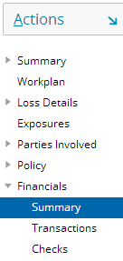
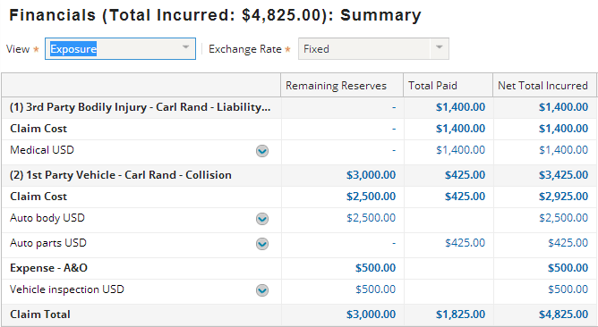
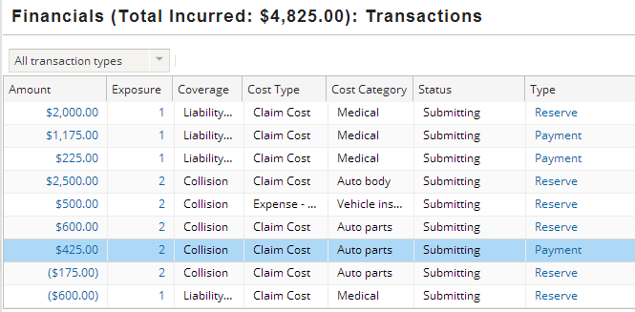
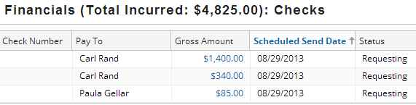
The financials screens
The Financials page includes a series of menu links to screens with information about reserves, payments and shortcuts to common financial tasks
Notes:
As always, the screens discussed on the next slides are provided in the ClaimCenter base application, but can be configured to meet particular business needs.

Slide 5
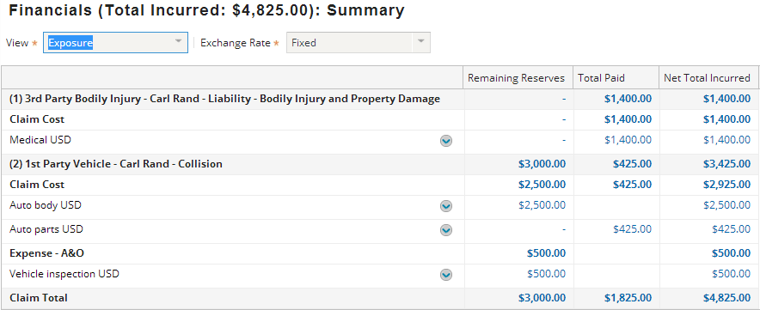
The summary screen
View dropdown
Status of each reserve line
Reserve lines, each with its own context menu ( )
Links to Transactions
The Summary screen lists reserve lines for the claim and the sums of transactions made against those lines
Notes:
The Summary screen provides a high-level summary of the financials for a claim.
The View dropdown is discussed on the next slides. Depending on the selected view, reserve lines are listed individually or summed together by exposure, claimant, or coverage.
In the example above, all final payments for the claim cost elements of the first exposure (1) have been made. Consequently, there are no remaining reserves for this reserve line. However, no payments have been made on the third or fourth exposures (the first-party exposures). Therefore, these exposures still have money in them.
Summary information is initially displayed only in the base currency. This is because each value could be the result of multiple transactions across three or more currencies.

Slide 6
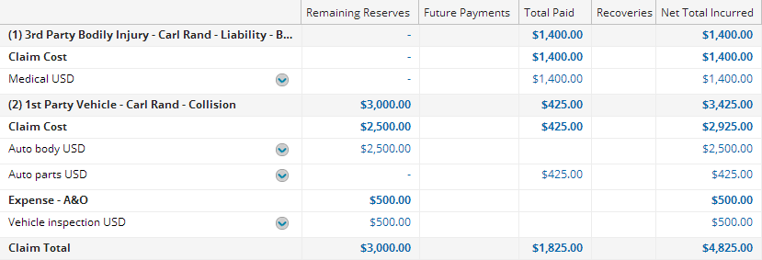
Summary screen terminology
Total Reserves = all approved reserves
Open Reserves = Total Reserves - Past Payments
Remaining Reserves = Open reserves - Future Payments
Available Reserves = Remaining Reserves - Pending Approval Payments
Gross Total Incurred = Open Reserves + Past Payments
Net Total Incurred = Gross Total Incurred - Recoveries
Notes:
The terms used to describe the finances for a claim are completely configurable. The definitions provided above are listed only to help identify the calculations already executed in the base application. All columns are shown in the above example, but, a user can hide or re-order columns themselves.
Available reserves does not appear on the summary screen in the base application, but it appears on screens in the payment wizard and it is used by business rules.
A reserve can be either approved or pending approval. The approval status affects whether it is included in open and remaining reserves.
A payment can be either in the past (it has already taken place) or in the future (it is scheduled to take place, which could include single future payments or recurring payments). The status of a payment affects the calculation for open reserves, remaining reserves, and available reserves.

Slide 7
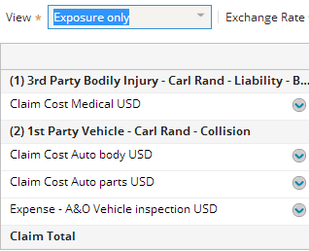
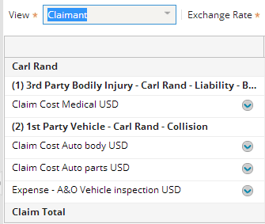
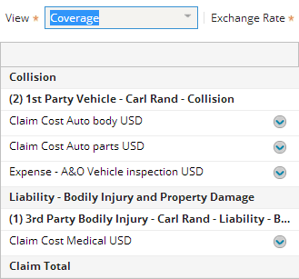
Review: summary screen views
You can have the Summary info grouped by exposure, claimant, coverage, claim cost only (omits expenses), or exposure only (omits the aggregation of cost categories under "Claim Cost" and "Expense" cost types)
Notes:
Recall that Financial Summary Views were discussed in the Reserves lesson in detail.

Slide 8
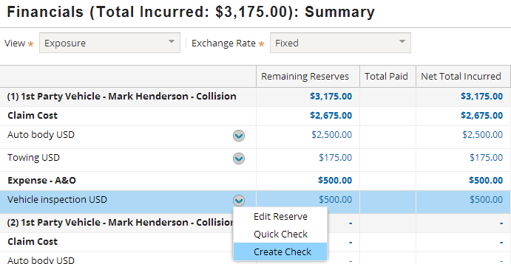

Summary screen context menu
Every reserve line has its own context menu which lets you:
Edit the money in that reserve line
Create a check with a single payment from that reserve line
Create one or more checks using a payment from that reserve line
Notes:
The Edit Reserves menu item navigates to the Set Reserves screen, but only the selected reserve line is displayed. (You can edit reserves only for open exposures.)
The Quick Check menu item navigates to an abbreviated form of the payment wizard which, in the base application, has the first and second step collapsed into a single step. A screenshot of this step is shown to the right (which is visible if you view PowerPoint in Notes view (View > Notes Page)). The final step is the same for both the Quick Check and regular payment wizard. Checks created using the Quick Check wizard can include only one payment transaction.
The Create Check menu item navigates to the full payment wizard. On steps 1 and 2 (Payees and Payments), the given payee and reserve line are automatically selected.

Slide 9
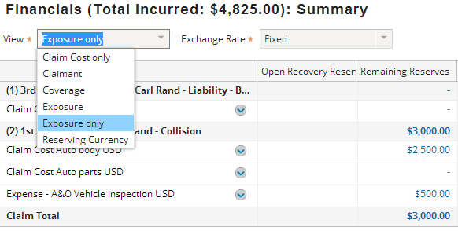
Common summary screen configurations
Changing the grouping options in the View dropdown
Modifying the column data to reflect financial calculations relevant to your business
Including/excluding expense lines for a given view
Notes:
The View dropdown is commonly configured so that views offered in the base application are removed and/or new views added. For example, you might want to remove the “Coverage" view and add an “Expense only" view (not shown).
The columns are also commonly configured. For example, you may want to remove the "Open Recovery Reserves" column or replace the “Remaining Reserves” with the “Available Reserves” calculation.

Slide 10
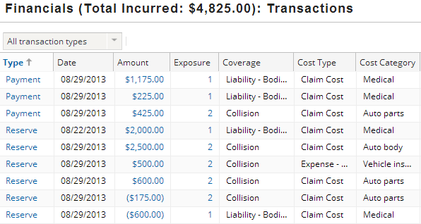
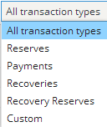
The transactions screen
The transactions screen lists all transactions of the filtered type for the claim
The Type and Amount columns contain links to a transaction detail view
The Exposure column contains links to the related exposure
Notes:
In the example above, notice the history of the Exposure 2 / Claim Cost / Auto parts reserve line.
On line 7, the reserve line was created with a reserve transaction of $600.
On line 3, a payment transaction of $425 was created against the reserve line. (This would leave $175 in the reserve line.)
On the last line, an offsetting reserve transaction removed $175 from the reserve line (hence the parentheses).
Based on this data, one could infer that the payment of $425 was a final payment, which triggered the second reserve transaction automatically to zero out the reserve line.

Slide 11
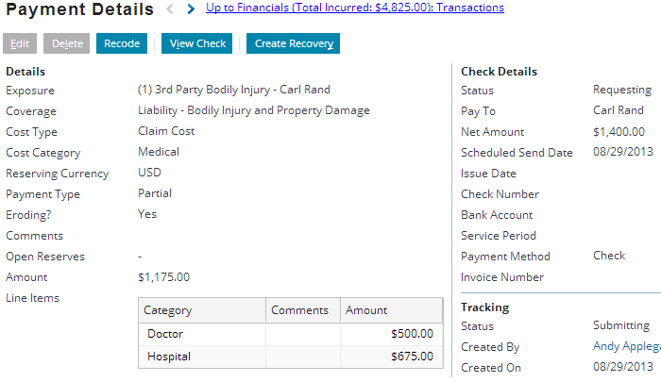
Viewing a transaction in detail
Notes:
An existing payment transaction can be edited, recoded (which moves it to a different reserve line, or deleted. However, the ability to do this does depend on the state of the transaction and the user's permissions. For example, the payment transaction shown in the screen above cannot be edited or deleted because the check to which the transaction is associated has a status of "requesting" (which can be seen in the Check Details section of the detail view). This means that the check has already been sent to the check printing system. (In general, a payment transaction can be edited or deleted if the check to which it is associated is at or before "Submitting" status.)

Slide 12
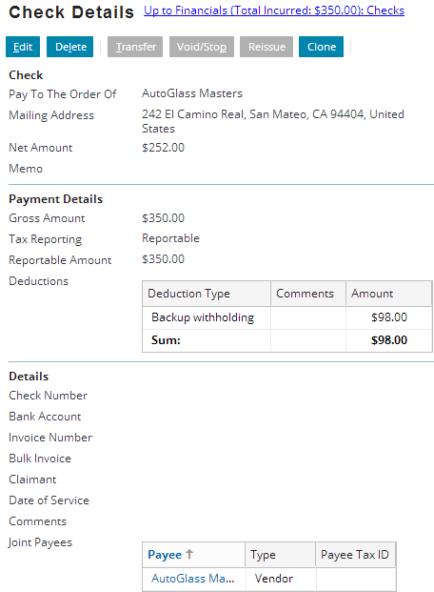

Check details
The Checks screen lists all checks created for the claim
The links in the Gross Amount column can be used to navigate to detailed information about the check
Notes:
An existing check can be:
Edited
Deleted
Transferred, which moves it to a different claim
Voided or Stopped, which cancels the check before (void) or after (stop) it has been sent to the payee
Reissued, which edits a check without affecting other checks in the checkset
Cloned, which copies it as a basis for a new check
The buttons to execute these actions are visible and available based on the status of the transaction, check, and/or the user's permissions. A full discussion of the manner in which each of these actions work is beyond the scoped of this course. For more information on modifying checks, refer to the ClaimCenter documentation.

Slide 13
Lesson objectives review
You should now be able to:
Use and navigate financials screens
This lesson uses the notes section for additional explanation and information. To view the notes in PowerPoint, choose View→Normal or View→Notes Page. If you choose to print the notes for the lesson, be sure to select “Print hidden slides.”

Slide 14
Review questions
Is it possible to create a check from the financials summary screen?
Are there any limitations on this check?
How is a quick check different from a regular check?
Notes:
Answers
1. Yes. You can create a check from the reserve context menu.
2. No. The only difference between entering the payment wizard from the Actions menu or from the reserve context menu is that entering from the reserve context menu allows ClaimCenter to pre-populate the payee and the reserve line for the initial payment.
3. The quick check wizard is an abbreviated form of the payment wizard. Checks created using the quick check wizard can include only one payment transaction.

Slide 15
Notices
Copyright © 2001-2014 Guidewire Software, Inc. All rights reserved.
Guidewire, Guidewire Software, Guidewire ClaimCenter, Guidewire PolicyCenter, Guidewire BillingCenter, Guidewire Reinsurance Management, Guidewire ContactManager, Guidewire Vendor Data Management, Guidewire Client Data Management, Guidewire Rating Management, Guidewire InsuranceSuite, Guidewire ContactCenter, Guidewire Studio, Guidewire Product Designer, Guidewire Live, Guidewire DataHub, Guidewire InfoCenter, Guidewire Standard Reporting, Guidewire ExampleCenter, Guidewire Account Manager Portal, Guidewire Claim Portal, Guidewire Policyholder Portal, ClaimCenter, BillingCenter, PolicyCenter, InsuranceSuite, Gosu, Deliver Insurance Your Way, and the Guidewire logo are trademarks, service marks, or registered trademarks of Guidewire Software, Inc. in the United States and/or other countries.
All other trademarks are the property of their respective owners.
This material is confidential and proprietary to Guidewire and subject to the confidentiality terms in the applicable license agreement and/or separate nondisclosure agreement.
This file and the contents herein are the property of Guidewire Software, Inc. Use of this course material is restricted to students officially registered in this specific Guidewire-instructed course, or for other use expressly authorized by Guidewire. Replication or distribution of this course material in electronic, paper, or other format is prohibited without express permission from Guidewire.
Guidewire products are protected by one or more United States patents.

